Slide 1
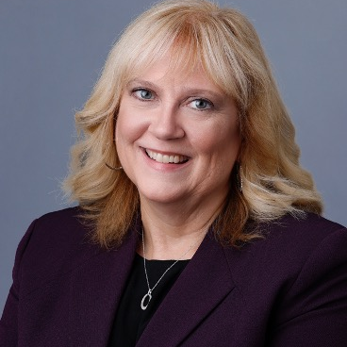
SWC PERSONNEL COMMITTEE
INTRODUCTION
Hi
CAROL TURPEN, Chair
Term through 2025
Member of First Church UCC
Current Moderator-elect

Slide 2
WHO WE ARE
Committee members and terms
ABOUT
WHAT WE DO
PERSONNEL
Purpose and Types of activities
RECENT ACCOMPLISHMENTS
Work we’ve done past year

Slide 3

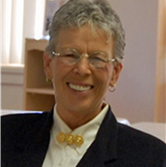
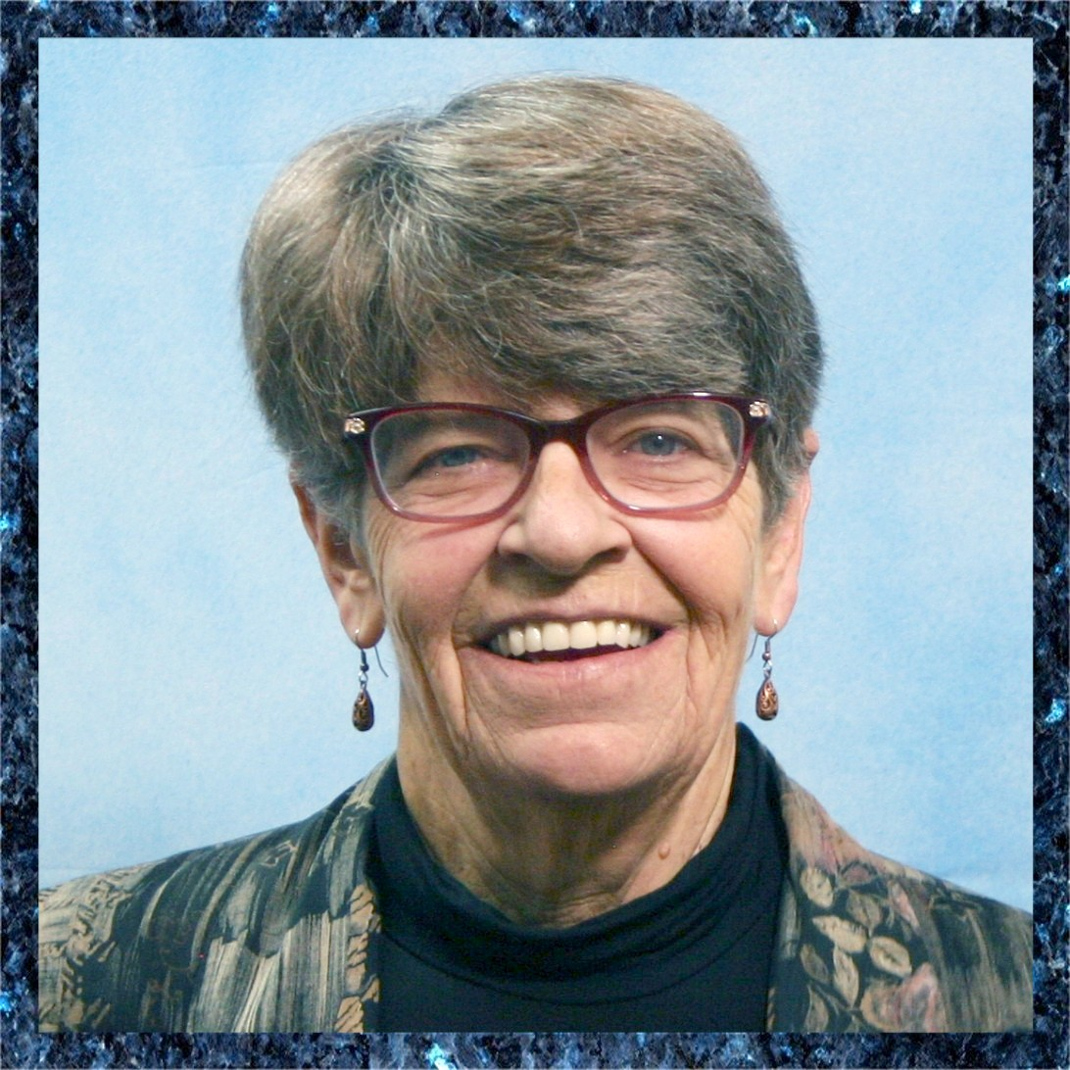
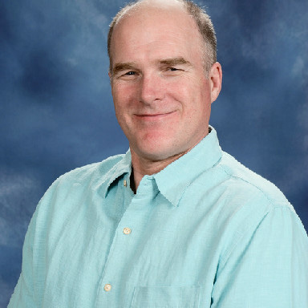
Personnel Committee
Meet monthly on first Tuesday at 4pm, MST
TBD
I was late to
ask for pics
ABOUT
US
Rev. Gloria Smith
Rita Bourgeois
Patty Lantrip
Rev. Randy Mayer
Board representative
Encanto Community Church UCC
Phoenix
Term through 2025
Casas Adobes Congregational UCC Tucson
Term through 2024 First Congregational UCC
Prescott
Term through 2024 First Congregational UCC
Sahuarita

Slide 4
What We Do
Activities can include:
Consultation on policy, procedure, or framework
Investigations
Objective 3rd party
Tools and resources
Cyclical processes
Our Purpose
The committee members are responsible for the maintenance and administration of the personnel policies, ensuring that the employment, supervision, development, recognition and separation of all Conference employees are fair, uniform and consistent with policy. Members are responsible for the biennial evaluation of the Conference Minister, must be able to maintain confidentiality and to interpret policies and guidelines as they apply to staff. Term of office: 3 years

Slide 5

HELPED UPDATE BYLAWS
DEALING WITH PERSONNEL
UPDATED POLICY MANUAL
REVISED CM/ACM JOB DESCRIPTIONS
DEVELOPED EVALUATION TOOLS FOR BI-ANNUAL STAFF REVIEWS
CLARIFIED REVIEW PROCESS
COMING UP…
MEET WITH THE BOARD TO ALIGN NEW PROCESSES AND TOOLS
RECENT
ACCOMPLISHMENTS

Slide 6


